Slide 1
The Solar System
6.1.3

Slide 2
Sputnik 1 1957 Took 98 minutes to orbit Earth. Lasted 3 months.

Slide 3
Explorer 1 1958 Stayed in orbit until 1970. Satellites in Earth’s orbit at 17,000 mph.

Slide 4
First Man In Space April 12, 1961 Yuri Gagaran- Russian 108 minutes orbiting Earth.

Slide 5
1st American In Space May 5, 1961 Alan Shephard

Slide 6
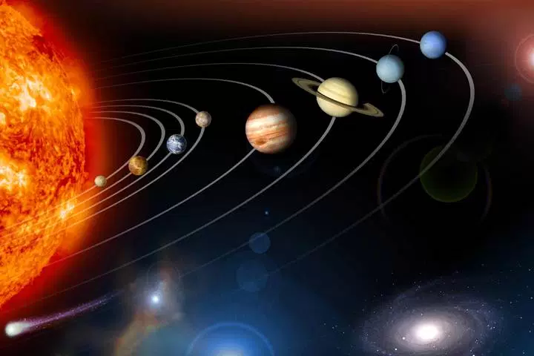
The solar system
Phenomenon- This image is one example of a model of our solar system.
What is useful about this model for understanding the solar system?
What are the limitations of this model?

Slide 7
Discuss and compare the two models of our solar system (the picture and the model I showed you) with a partner. How are they similar? How are they different?

Slide 8
Planet Mnemonic
Planet
Mercury | My
Venus | Very
Earth | Eager
Mars | Mother
Jupiter | Just
Saturn | Served
Uranus | Us
Neptune | Nine
Pluto | Pizzas

Slide 9
Draw a 2D model of the solar system. Make sure that everything is labeled.

Slide 10
Solar System To Scale Video

Slide 11
The Great Planetary Debate
You and your partner will choose a planetary body from the list. No duplicates.
Research your topic and fill out information sheet.
Write an opening and a closing argument. One person will do opening and the other person will do the closing.

Slide 12
Debate Schedule
Team One- Opening Statement (30 seconds)
Team Two- Opening Statement (30 seconds)
Team One- Rebuttal (90 seconds)
Team Two- Rebuttal (90 seconds)
Team One- Closing Statement (30 seconds)
Team Two- Closing Statement (30 seconds)

Slide 13
Grading
Class Work and Participation- 20 pts
Information Sheet- 20 pts
Opening & Closing Statements- 40 pts
Debate Participation- 10 pts
Being a Good Audience- 10 pts

Slide 14
Give details and make sure it is interesting. You want the class to vote for your planetary body.
Look up details about opponents for rebuttal.
No negative or bad statements. Make sure everything is positive!!

Slide 15
Measuring Distances
Light Year- The distance light travels in one year.
Astronomical unit- AU - a comparison measurement.
1 AU = the distance between the Sun and the Earth.

Slide 16
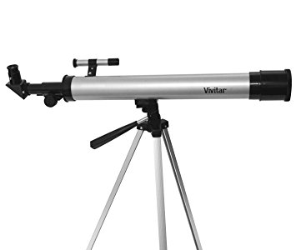
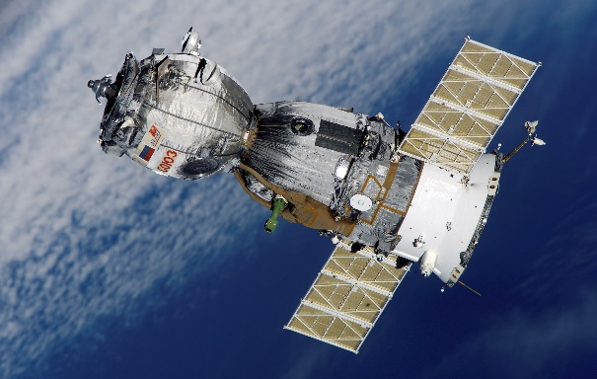
Telescope-an optical instrument designed to make distant objects appear nearer.
Satellite-an artificial body placed in orbit around a planet in order to collect information or for communication.

Slide 17
Let’s begin with the Earth’s distance from the Sun to see how this works. Earth is about 93,000,000 miles (150,000,000 kilometers) away from the Sun. A beam of light from the Sun takes 8.3 minutes or about 500 seconds to reach the Earth. Speed of light, the time it takes light to travel, is about 186,000 miles per second (300,000 kilometers per second). The speed of light is much faster than rockets can travel today.

Slide 18
Light-Year Calculation
60 seconds per minute (x) 60 minutes per hour = 3,600 seconds per hour.
3,600 seconds per hour (x) 24 hours per day = 86,400 seconds per day.
86,400 seconds per day (x) 365 days a year = 31,536,000 seconds per year.
31,536,000 seconds per year (x) 186,000 miles per second = 5,865,696,000,000 miles per year= 1 light-year in miles.

Slide 19
Surfing the Solar System
https://www.astrosociety.org/edu/surfgame.html
Another scale model (I like this one better)- computer
http://joshworth.com/dev/pixelspace/pixelspace_solarsystem.html

Slide 20
Which planet has the shortest day?
Which planet has the longest year?
Which planet has a year that is shorter than its day?
Which planet has the most gravity?
Which planet has the least gravity?

Slide 21
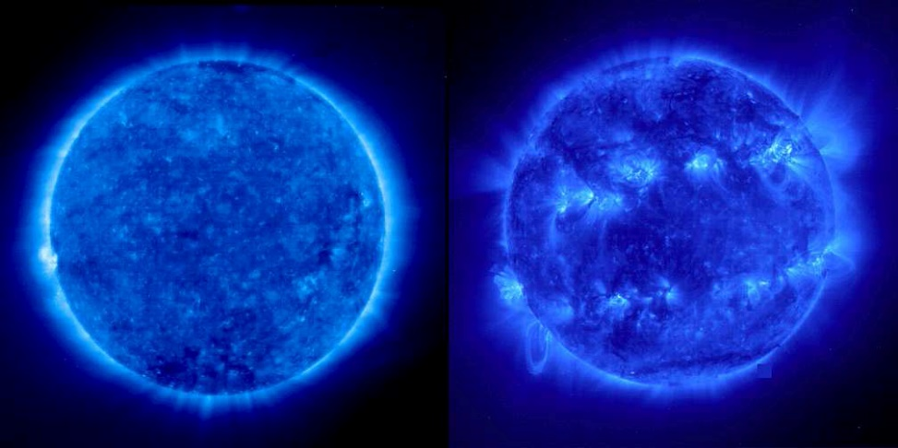
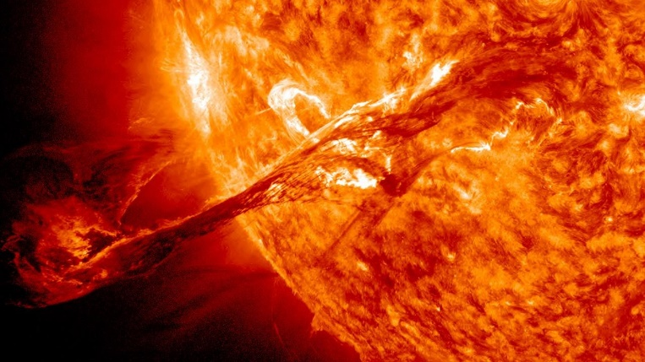
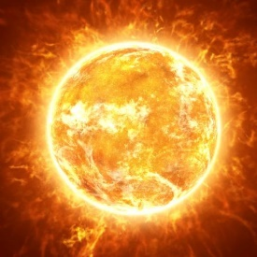
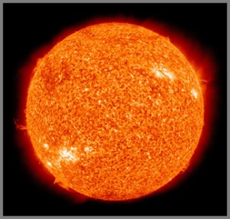
The Sun
The sun is an average star but it is the largest thing in our solar system.
The sun is 500 times the mass of everything else in the solar system combined.
Orbits are elliptical and all move counter-clockwise

Slide 22
The Inner Planets
The four planets closest to the sun- Mercury, Earth, Venus and Mars- are called the terrestrial planets because they have solid, rocky surfaces.
Planet- a large, round mass that orbits a star and shines with light reflected from the star.

Slide 23
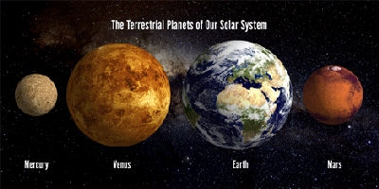
What makes a planet a planet?
All planets revolve around the sun counter-clockwise in a slightly elliptical shape.
Is in orbit around the sun.
Has sufficient mass to assume a nearly round shape.
It is not a satellite (moon).
It has cleared its orbit of smaller objects.

Slide 24
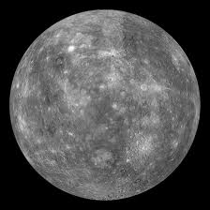
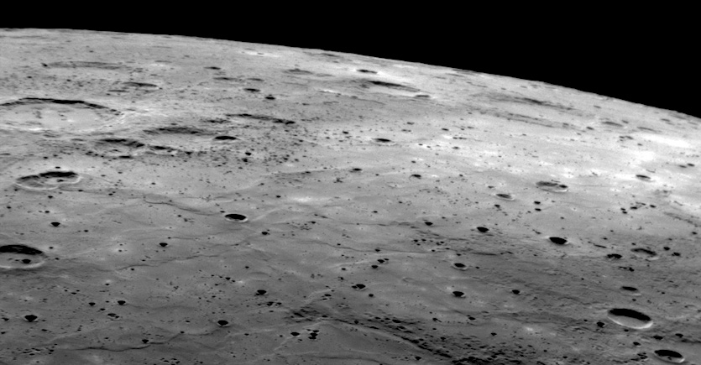
Mercury
Mercury is the nearest planet to Sun.
Our Moon and Mercury’s surface are similar.
It has a very thin atmosphere it has no moons.
Daytime Temperature: 662ºF
Nighttime Temperature: -274ºF
Rotation: 58.7 days
Revolution: 88 days
Distance from Sun: 0.39AU

Slide 25
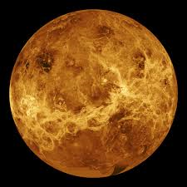
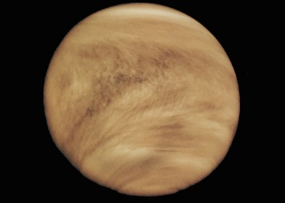
Venus
2nd planet from the Sun.
Spins slowly backwards as it orbits the Sun.
Its atmosphere is mostly made up of CO₂.
Atmosphere traps heat making Venus the hottest planet. 860ºF
Surface is dominated largely by volcanic activity.

Slide 26
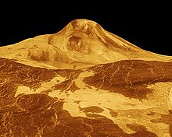
venus
Very few craters on Venus.
No moons.
Rotation: 243 days
Revolution: 224.7 days
Distance from the Sun: 0.72 AU

Slide 27
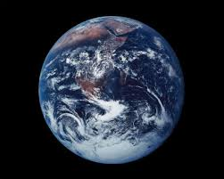
Earth
3rd planet from the Sun.
Covered by about 70% water and 30% land.
One large moon.
Only conditions necessary for life as we know it in our solar system.
Has volcanoes, mountains, earthquakes and a few craters.
Rotation: 24 hours
Revolution: 365.25 days
Distance from Sun: 1 AU

Slide 28
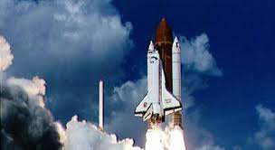
The Moon
First astronauts walked in powdery dust.
Footprints are still there. No wind.
Light colored areas are craters, highlands and mountains.
Dark areas are plains.
Some of plains were made when huge space rocks hit the moon and they later filled in with lava.
The moon has no air, wind, or water so it has no erosion.

Slide 29
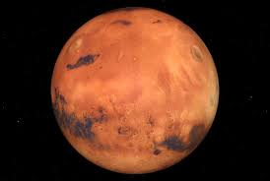
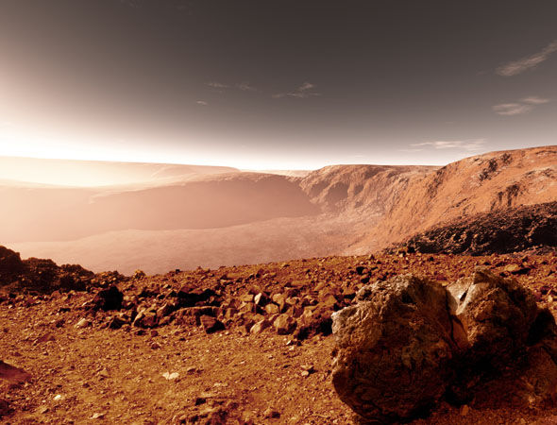
mars
4th planet from the Sun.
Iron oxides (rust) cause its surface to be reddish in color.
It has polar ice caps made of frozen carbon dioxide and water ice.
2 small moons (Phobos & Deimos)
Thin atmosphere, less than 1% of Earth’s.
Huge dust storms sometimes cover the surface.
Rotation: 24.6 hours
Revolution: 678 days
Distance from Sun: 1.52 AU

Slide 30
Mars One
First group leaves 2031.
2 men & 2 women
2 years later they will send 4 more people.
This is a one way trip.

Slide 31
Olympus Mons is the largest volcano in our solar system. It rises up 78,000 feet (3 times the size of Mt. Everest.)

Slide 32
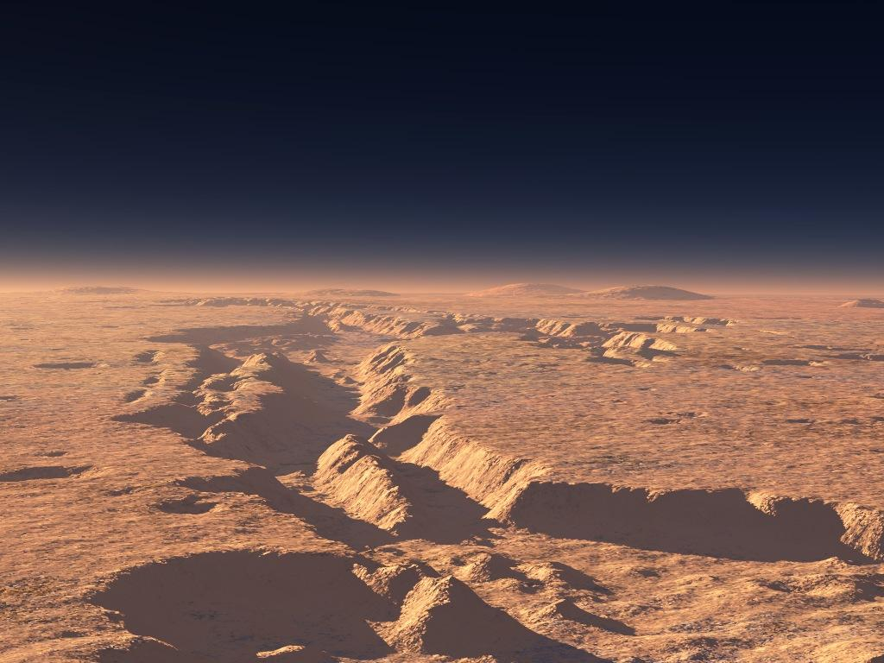
Mars
Another feature on Mars is Valles Marineris. This is a network of canyons that are 4000 km long and 7 km tall.

Slide 33
Phobos & Deimos
Mars has 2 moons which are called Phobos and Deimos (asteroids, not round)
Extremely small. Smaller than most towns.
Phobos is moving towards Mars and will eventually crash into it.

Slide 34
Asteroid Belt
Between Mars and Jupiter.
1st discovered in 1801.
Mostly small rocks and dust.
Space between the asteroids is 600,000 miles.

Slide 35
The Asteroid Belt
The gravity of Jupiter fights with the gravity of the sun to prevent planet formation.
Two planetary objects collided forming the asteroid belt.
Asteroid- a small rocky body (that is not a planet) orbiting the sun.

Slide 36
Asteroids

Slide 37
Ceres
1st to be considered an asteroid.
In 2006 it became a dwarf planet.
May have water and an atmosphere.
1/3 of the mass of the asteroid belt.

Slide 38
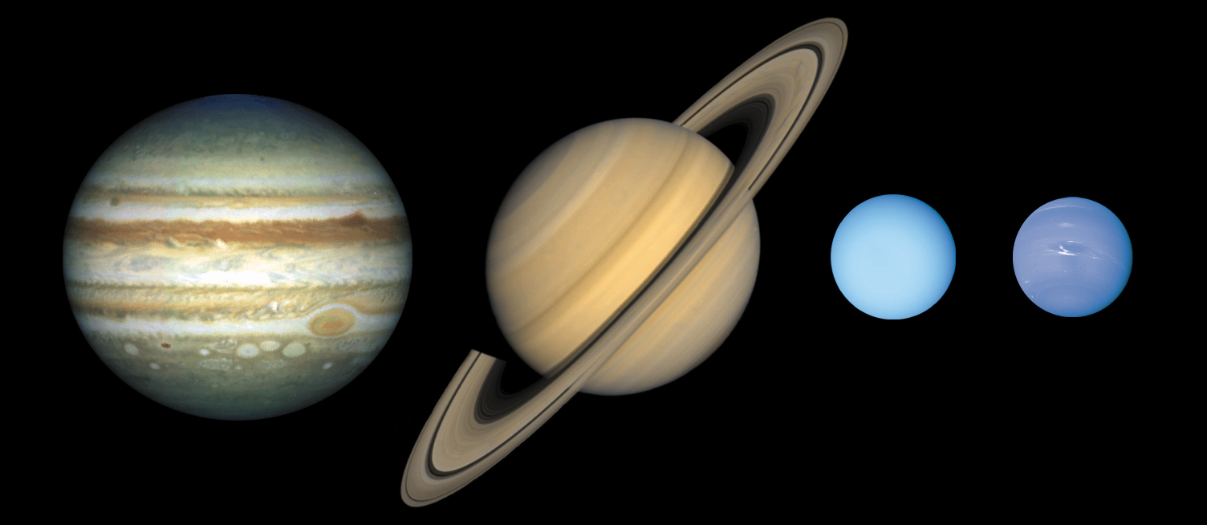
The Outer Planets
The outer planets beyond the orbit of Mars are gas giants. These planets are called Jupiter, Saturn, Uranus & Neptune. Two of the outer planets (Uranus and Neptune) are also called ice giants.

Slide 39
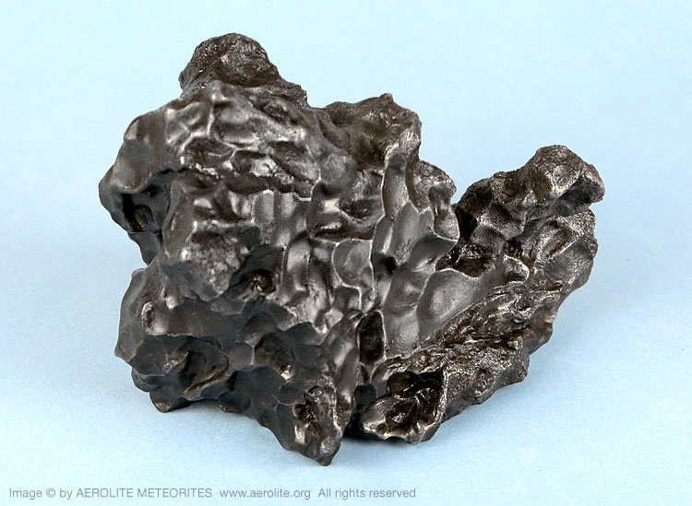
Meteorites
Meteoroids- chunks of rock and debris flying through space.
Meteoroids become meteors- or shooting stars- when they interact with a planet’s atmosphere and cause a streak of light in the sky.

Slide 40
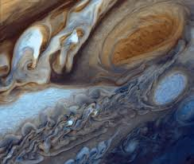
jupiter
5th planet from the Sun.
Largest planet.
Atmosphere is made mostly of hydrogen, helium and methane.
Great Red Spot is a storm that has lasted for 400 years.
Very small and faint ring system. Discovered by Pioneer 10.

Slide 41
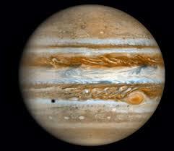
Jupiter
4 large and 59 small moons for a total of 63 moons.
Rotation: 9.9 hours
Revolution: 11.9 years
Distance from the Sun: 5.2 AU.
Ganymede is the largest moon in our solar system. It is larger than Mercury.
4 largest moons are Ganymede, Callisto, Io and Europa.

Slide 42
Moons of Jupiter

Slide 43
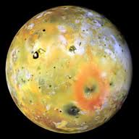
Io- endless volcanic activity.

Slide 44
Europa- Thick surface ice with ocean underneath.
Slightly smaller than our moon.
Possibly twice as much water than Earth.

Slide 45
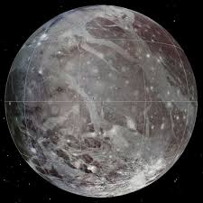
Ganymede- largest moon in our solar system.
May have a salty ocean.
First seen in 1610.

Slide 46
Callisto- unchanged for 4 billion years.
Ancient cratered surface.
Most heavily cratered object in our solar system.
No activity.

Slide 47
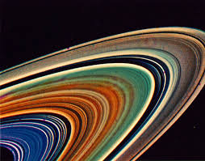
saturn
6th planet from the Sun.
Second largest planet.
Atmosphere made up of hydrogen, helium & methane.
53 officially named moons.
It’s largest moon Titan is larger than Mercury.
Not very dense. Because of this is would float in a giant bathtub of water.

Slide 48
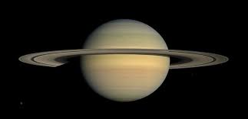
saturn
Large ring system. Saturn and its rings would fit between Earth and the Moon.
Rotation: 1.7 hours
Revolution: 29.4 years
Distance from Sun: 9.58 AU

Slide 49
Titan- Earth-like landscape. Liquid methane instead of water and water ice instead of rock.

Slide 50
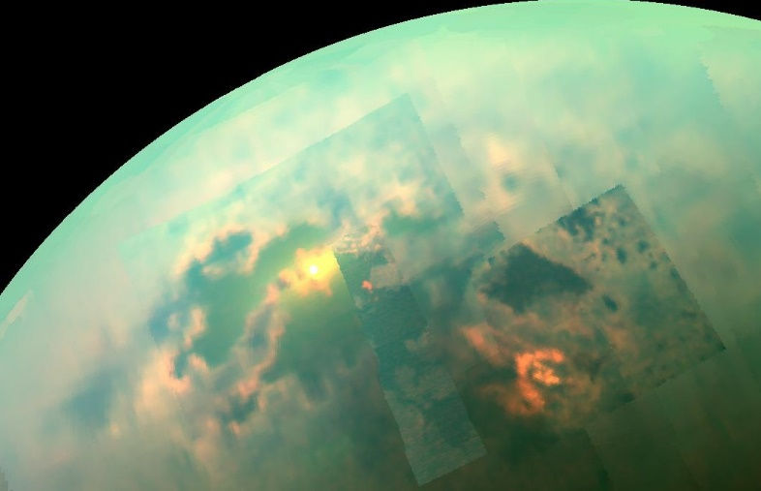
Titan
Only moon known to have an atmosphere.
Volcanoes spew ice instead of lava.

Slide 51
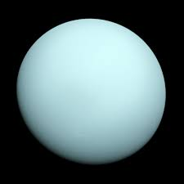
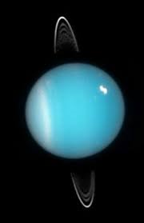
uranus
7th planet from the sun.
Third largest planet.
Small faint ring system.
Its axis points toward the Sun so it rotates on its side.
27 moons.
Atmosphere of hydrogen, helium and methane.
Methane causes it to look blue.
Rotation: 17.2 hours
Revolution: 83.7 years
Distance from Sun: 19.2 AU

Slide 52
Umbriel- mostly ice with a little bit of rock.

Slide 53
Miranda- scarred surface with concentric canyons.

Slide 54
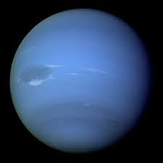
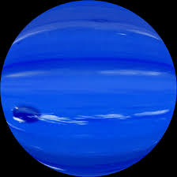
neptune
8th planet from the Sun.
Sometimes it has a great dark spot that is a huge storm system the size of Earth.
Has the fastest winds in the solar system.
Atmosphere is made up of hydrogen, helium and methane.
Neptune has 14 moons.
Its moon Triton has an atmosphere.
It has a small faint ring system.
Rotation: 16.1 hours
Revolution: 163.7 years
Distance from the Sun: 30.05 AU

Slide 55
Triton- colder than Pluto, but alive with geysers.

Slide 56
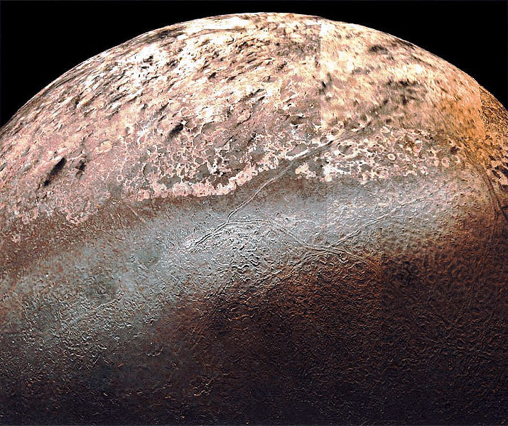
Triton
Discovered in 1846.
Colder than Pluto.
Icy volcanoes that spew Nitrogen gas.
Eventually will collide with Neptune.

Slide 57
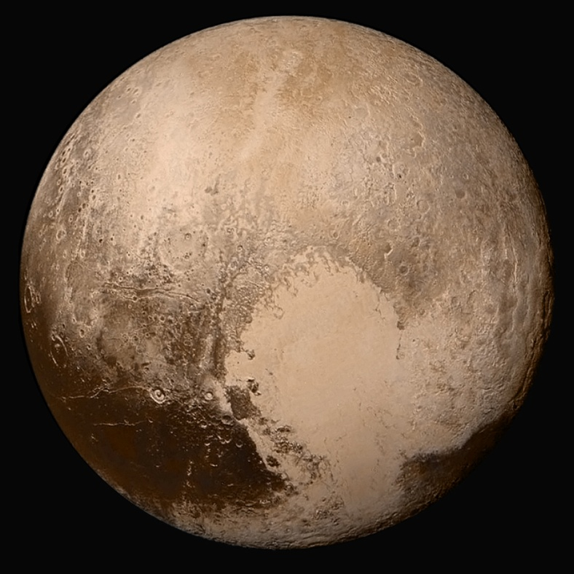
Pluto
Pluto has 5 moons, the biggest moon is called Charon. This moon is half the size of Pluto. Sometimes Pluto’s orbit crosses in front of Neptune’s. So sometimes Pluto is the farthest out and sometimes Neptune is farther out.
Pluto and Neptune will never
collide because Pluto’s orbit
is tilted.

Slide 58
Charon
Frigid surface covered in methane and nitrogen ice.
If not orbiting Pluto it would be a dwarf planet.
May have ice volcanoes.

Slide 59
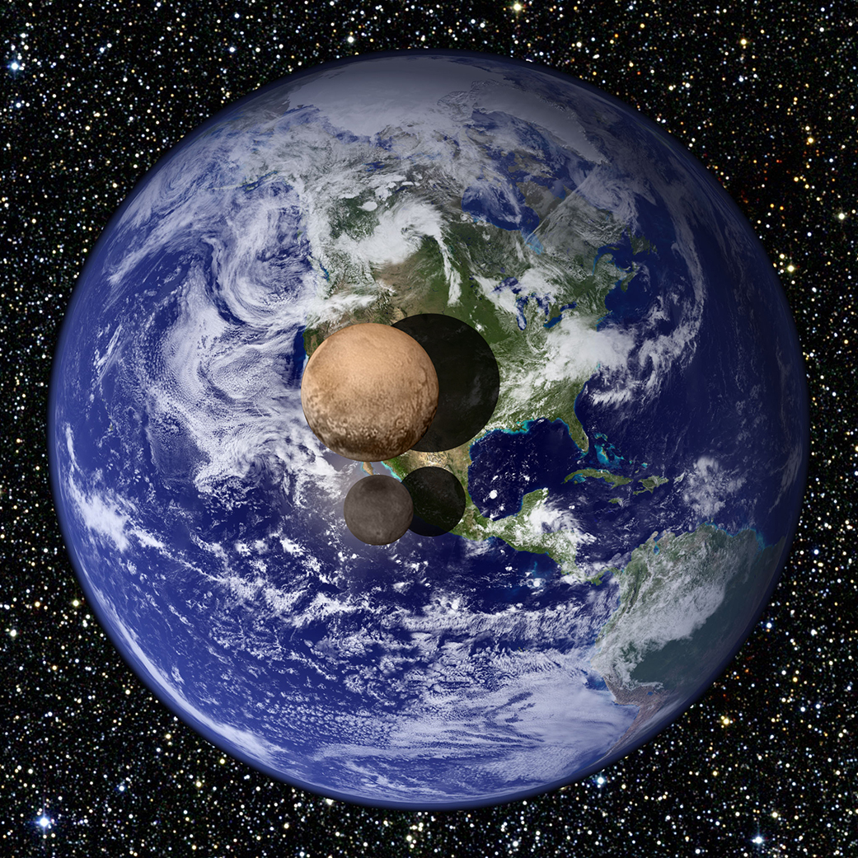
Pluto and Charon compared to the size of Earth.

Slide 62
Kuiper Belt & Oort Cloud
The Kuiper Belt and the Oort Cloud are regions of space. The known icy worlds and comets in both regions are much smaller that Earth’s moon.
The Kuiper Belt is a doughnut-shaped ring extending just beyond the orbit of Neptune. The Oort Cloud is a spherical shell.

Slide 63
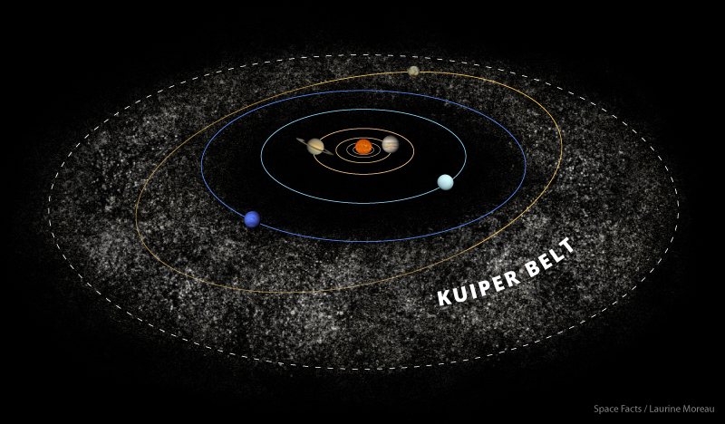
Kuiper Belt
fdas

Slide 64
Oort Cloud

Slide 65
Dwarf Planets
Must orbit a star.
Need to have enough mass to be nearly spherical.
Not have cleared the area around its orbit of smaller objects.
Not be a moon.

Slide 66
Dwarf Planets
Dwarf Planet | Diameter (km) | # of Moons | Location
Pluto | 2400 km | 5 | Kuiper Belt
Ceres | 950 km | 0 | Asteroid Belt
Haumea | 1916 x 1518 km | 2 | Kuiper Belt
Makemake | Between 1360-1480 km | 0 | Kuiper Belt
Eric | 2326 km | 1 | Kuiper Belt

Slide 67
Dwarf Planets
Astronomers know that there may be other dwarf planets far out in the solar system. Look for Quaoar, Varuna and Orcus to possibly be added to the list of dwarf planets in the future.

Slide 68
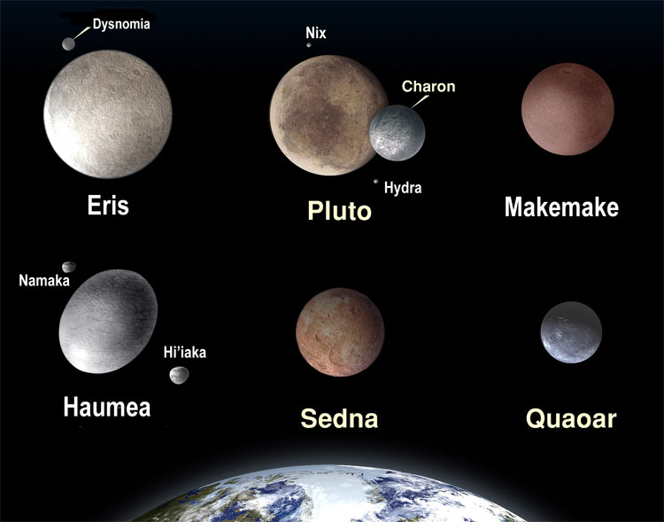

Slide 70
What patterns can you identify among the planets that have a larger diameter?
What properties differentiate a dwarf planet and a planet?
What is AU? Why is this unit used to measure distances in the solar system?

Slide 71
Parts of a comet

Slide 72
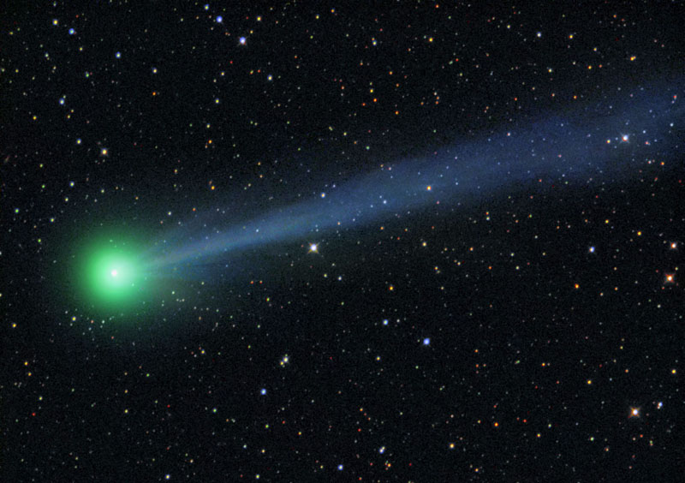
Comets
Comets are cosmic snowballs of frozen gases, rock and dust.
A comet warms up as it nears the sun and develops an atmosphere, or coma. The coma may be hundreds of thousands of kilometers in diameter.
The tail of a comet always
points away from the sun due
to solar wind.

Slide 73
Planet Nine

Slide 74
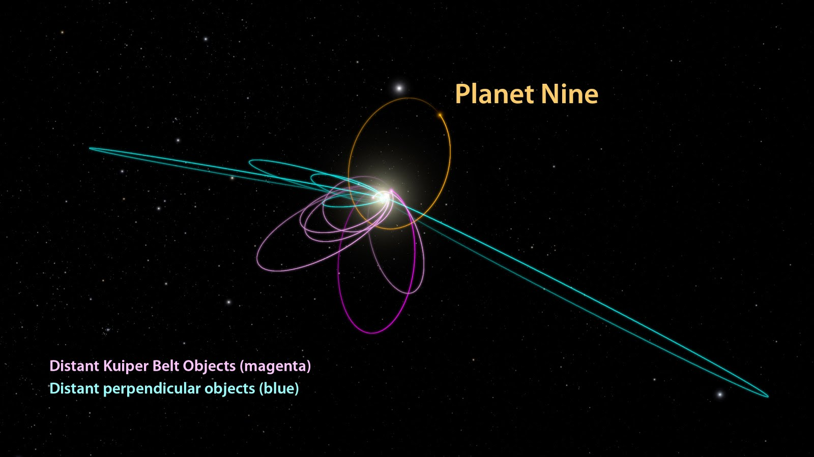
Planet Nine
Existence predicted by math.
Dominates a region larger than any other planet.
Take 10,000-20,000 years to orbit sun.

Slide 75
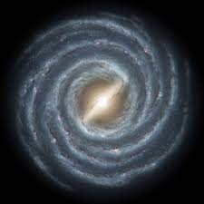
The Milky Way

Slide 76
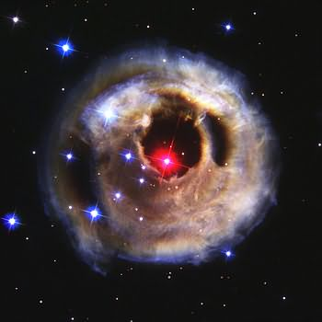
Monocerotis – Star in outer edges of Milky Way
Eagle Nebula

Slide 77
Video- Comparison of planets and stars.
https://www.youtube.com/watch?v=Ov5AHcCQtd8

