Slide 1
Gravity & Inertia In our Solar system
6.1.2

Slide 2
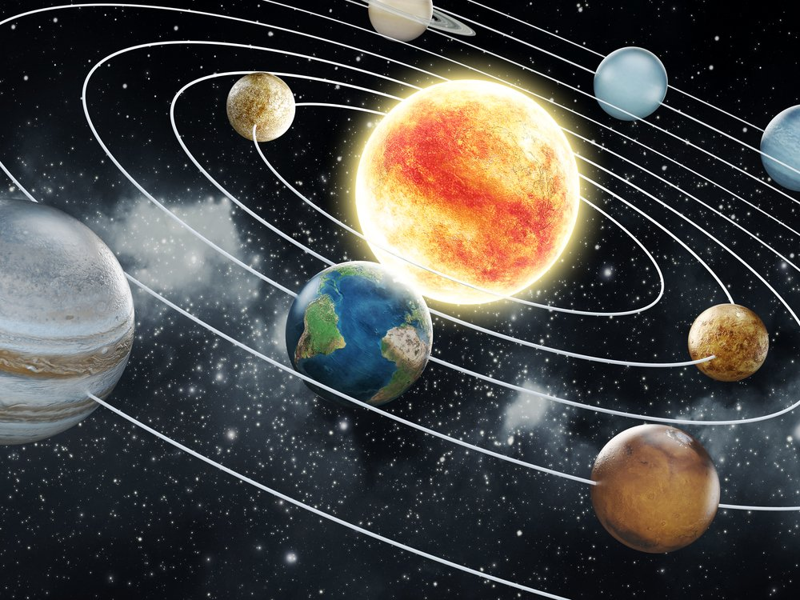
System-a set of connected things or parts forming a complex whole.
Model- a three-dimensional representation of a person or thing, typically on a smaller scale than the original.
Scale is when we compare its size to the size of something else.

Slide 3
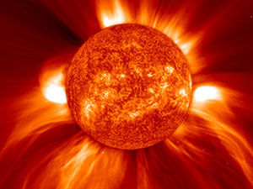
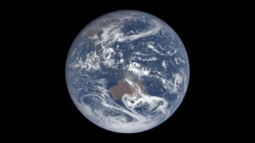
Sun- Star at the center of our solar system.
Planet- an astronomical body orbiting a star.

Slide 4
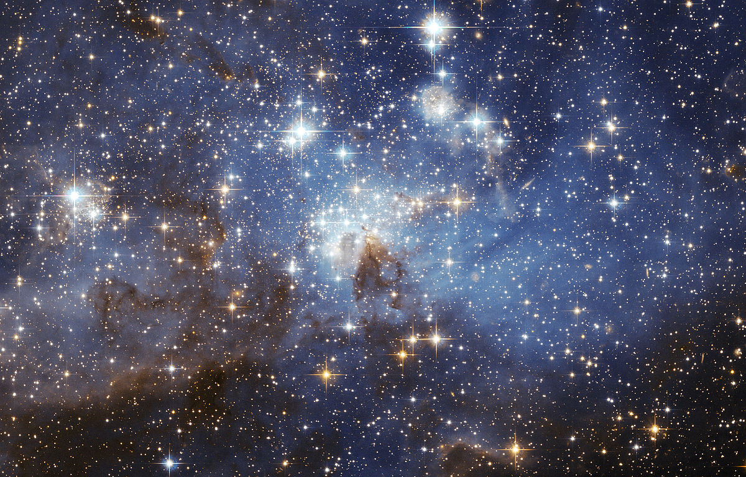
Star- a luminous sphere of plasma held together by its own gravity.

Slide 5
Explain how the above terms are all related to one another. Include all of the following words in your explanation: system, scale, sun, planet, star and model.

Slide 6
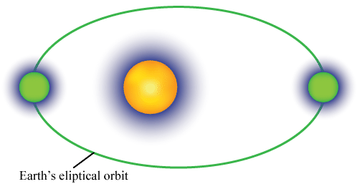
Phenomenon- the picture above shows the earth in orbit around the sun. Explain why objects in the solar system stay in orbit around the sun.

Slide 7
How does gravity relate to our solar system?
How would you define or describe gravity?

Slide 8
What are some examples or evidence of gravity?
How does gravity work?

Slide 9
PhET simulation- Gravity & Orbits https://phet.colorado.edu/en/simulations/category/new

Slide 10
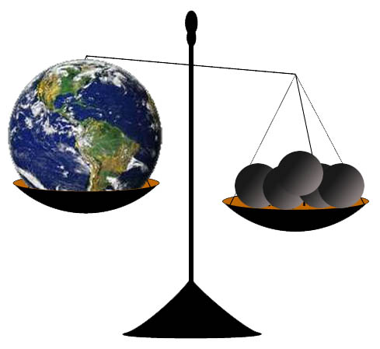
The role of gravity and inertia
Mass is a measure of the amount of matter in an object.
Everything that has mass has gravity.

Slide 11
Gravity is the attraction of one particle or body to another.
The Sun is largest mass in solar system
Gravity is dependent on the mass of the objects and the distance between the 2 objects.

Slide 12
Draw a picture of gravity

Slide 13
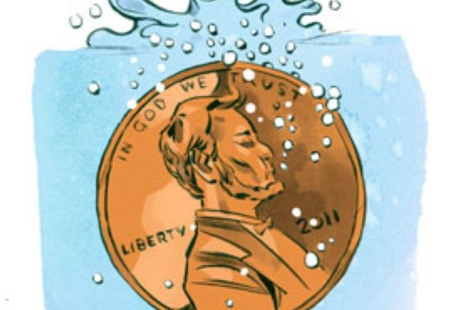
The Magic of Gravity Lab

Slide 14
Gravity Visualized video.
Take notes on page 34 in your science notebook.
https://www.youtube.com/watch?v=MTY1Kje0yLg

Slide 15
Inertia
Inertia- the tendency of an object to resist a change in its motion.
All objects have inertia and the inertia of an object depends on its mass.

Slide 16
Inertia and Mass Video
Take notes on page 35 in your science notebook.
https://www.youtube.com/watch?v=YbWjx3LUc0U

Slide 17
Marble Activity
Place the marble on the paper in the tray. Invert the plastic cup over the marble.
Move the cup in a rapid circular motion, causing the marble to move around the inside edge of the cup.
While the marble is moving rapidly in the cup, lift the cup straight up off the paper.

Slide 18
On page 49 in your science notebook explain what happens to the marble.
Repeat the activity, paying careful attention to the path the marble takes after lifting the cup.
Explain the marble’s motion.
Draw an explanation of the marble’s motion on page 49; be sure to label the drawing.

Slide 19
What kept the marble moving?
How does the concept of inertia apply to this activity?

Slide 20
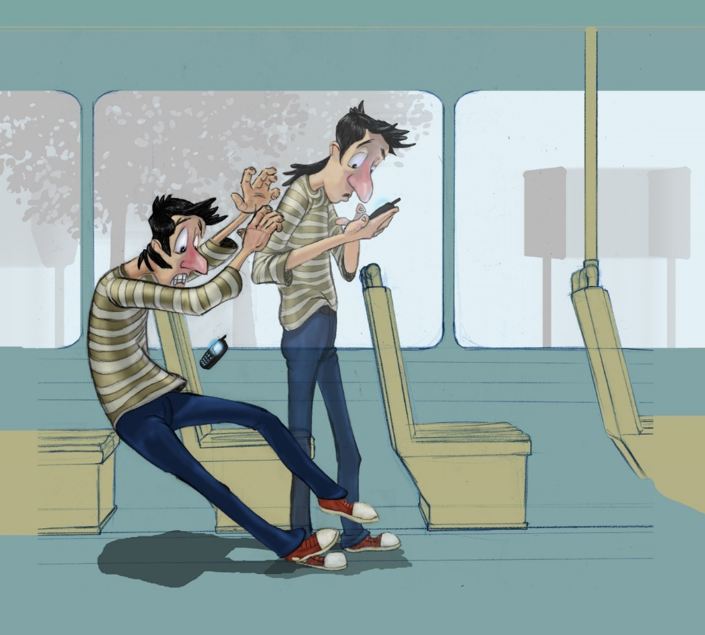
Draw a Picture of Inertia

Slide 21
The Earth's inertia keeps it moving forward at the same time that it is pulled by the Sun's gravitational force. Working together they both keep Earth in orbit around the Sun.
Orbital motion occurs whenever an object is moving forward and at the same time is pulled by gravity toward another object.

Slide 22
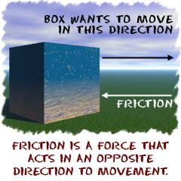
Friction- the resistance that one object encounters when moving over another.

Slide 23
Draw a picture of friction

Slide 24
Friction (forces and Motion) video
Take notes on page 35 in your science notebook.
https://www.youtube.com/watch?v=MztWyY9z1jY

Slide 25
Force-A push or a pull

Slide 26
Gravity Force and Work Video
Take notes on page 35 in your science notebook.
https://www.youtube.com/watch?v=LEs9J2IQIZY

Slide 27
List 3 things you have learned about gravity and inertia.

Slide 28
Just as Earth orbits the Sun, moons also orbit planets. The moon is affected by Earth’s gravity more than it is by the Sun’s gravitational pull because the Moon is much closer to Earth. The Earth’s gravity pulls the Moon toward Earth. At the same time, the Moon has forward movement, or inertia, that partly counter the force of Earth’s gravity. This inertia causes the Moon to orbit Earth instead of falling toward the surface of the planet.

Slide 29
The figure below shows the forces involved in the Moon’s orbital motion around Earth. In the diagram, (v) represent the forward movement, or velocity, of the Moon, and (a) represent the gravity between Earth and the Moon. The line encircling Earth shows the Moon’s actual orbit which results from the combination of v and a.

Slide 30
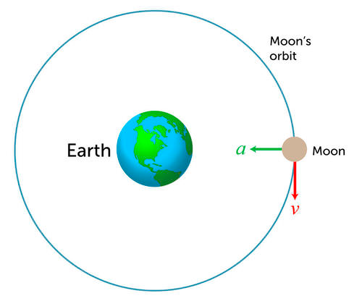
Forces Keeping Things in orbit

Slide 31
Why is the sun called the center of our solar system?
Why doesn’t earth crash into the sun?

Slide 32
Why does the moon maintain its orbit around earth? Make sure you discuss the two forces involved.
Explain why objects in the solar system stay in orbit around the sun.

Slide 33
Planetary motion lab

