Slide 1
Atoms & Molecules
6.2.1

Slide 2
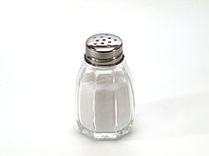
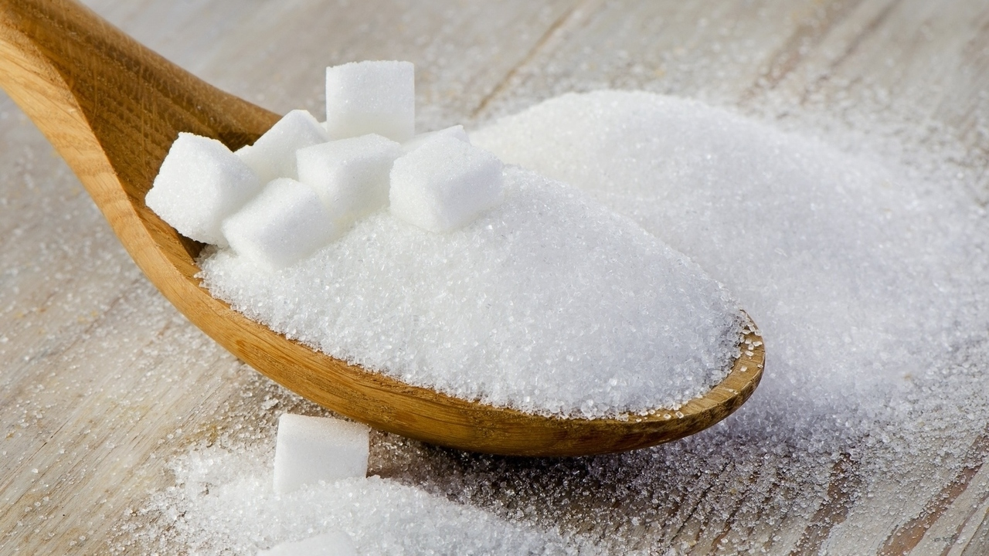
Atoms & Molecules
Phenomenon- salt and sugar look and feel similar. However, they do not taste similar.

Slide 3
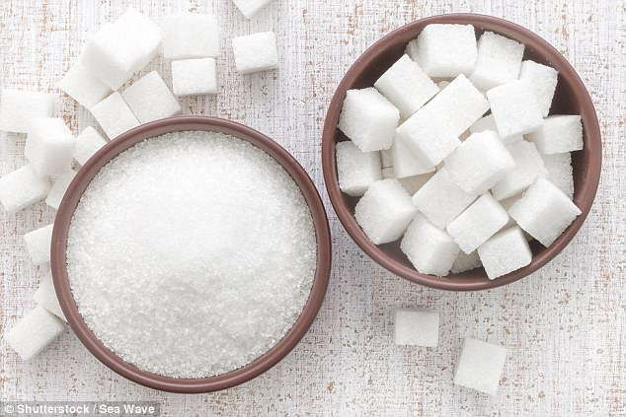
Salt & Sugar
Develop an explanation how matter such as sugar and salt may look similar but taste very different.

Slide 4
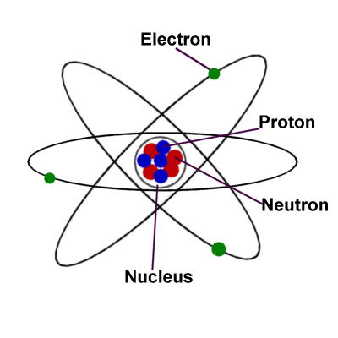
Atoms
Atom- the basic building block of matter.
Everything is made of atoms.

Slide 5
Just How Small is an Atom Video
https://www.youtube.com/watch?v=yQP4UJhNn0I

Slide 6
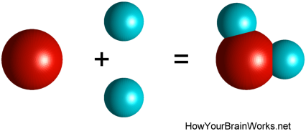
Molecules
Atoms combine to form molecules.
Draw a picture of this:

Slide 7
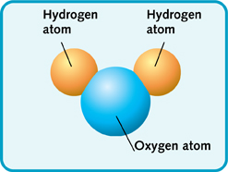
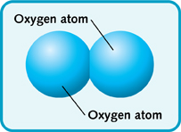
Molecules
Molecule- A group of atoms bonded together.
Molecules always have the same type of atoms in the same proportions.
Oxygen Water

Slide 8
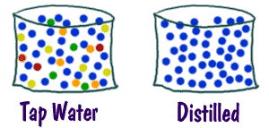
Pure Substance vs. Mixture
A pure substance always has the same composition throughout- every molecule is exactly the same.
Draw a picture of a pure substance and a mixture.
Mixture → ← Pure Substance

Slide 9
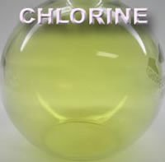
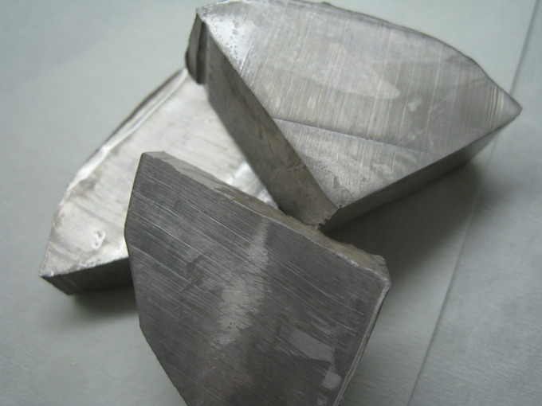
Properties of molecules are different from the properties of the atoms that make them up.
Sodium- Metal Chlorine- Gas

Slide 10
Sodium vs. Chlorine
Atom- Sodium
Properties- solid, metal, silver, reacts with water, explosive
Atom- Chlorine
Properties- gas, yellow/green, Nazi’s used it to kill people

Slide 11
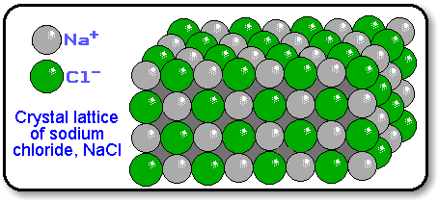
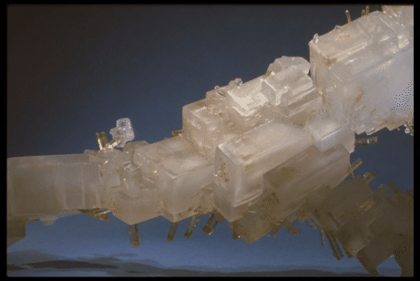
Sodium Chloride- Table Salt
Molecule- sodium chloride
Properties- solid, white, tastes salty, harmless

Slide 12
Explain why sodium and chlorine atoms by themselves are so different from the molecule sodium chloride.

Slide 13
Making Molecules
Carbon Atoms- Black
Oxygen Atoms- Blue
Nitrogen Atoms- Red
Hydrogen Atoms- White

