Slide 1
Stability & Change
6.4.5

Slide 2
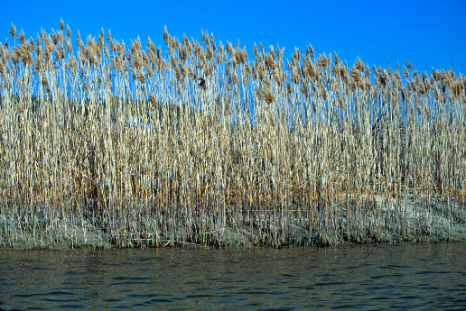
Phenomenon- phragmites are plants that grow near many of Utah’s waterways. These plants are causing concern for the division of natural resources because they overtake native species of plants. Develop an initial claim for why phragmites are a problem in Utah and for how the division of natural resources might address this problem.

Slide 3
Ecosystem services- the positive benefits that ecosystems provide to people.
Clean drinking water, timber, plants used for medicine
Are important because they help us regulate flooding, soil erosion, forest fires and water pollution. They also provide us with places we can go for outdoor recreation activities.

Slide 4
Wetlands play a key biological role by removing pollutants from water.
Healthy forests provide us with both goods and services. Timber, habitat for many animals, decomposition on forest floor recycles,. Help prevent flooding by containing water in the soil and slowly releasing water over time.
Deserts- recreation and tourism.

Slide 5
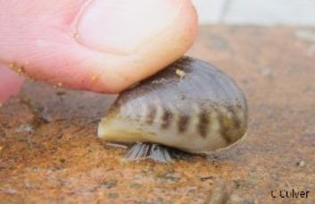
Invasive species- a species not native to an ecosystem and causes harm to that ecosystem.
Quagga mussels can be found in some of Utah's lakes- eat plankton depleting food supply.
Boaters are required to clean drain and dry their boats at stops along the highway.

Slide 6
In June 2010 a fracture in an oil pipeline caused about 30,000 gallons of oil to spill into red butte creek in Salt Lake City. The oil spill harmed aquatic wildlife including fish birds and insects.
With the spread of urban areas air quality becomes a concern.
Wintertime inversions

Slide 7
Describe an ecosystem services that affects us.
What are some ecosystem services provided by the ocean?
What can you do to help preserve ecosystems in Utah?

